Slide 1
C Program
15th Group

Slide 2
Periodic Table of Elements
Part 1

Slide 3

Part 1
Periodic Table of Chemical Elements
1
Design Ideas
2
Function & Highlights
3
Main Codes
4
Demonstration

Slide 4
Design Ideas
Periodic Table of Chemical Elements
Two-dimensional array represents chemical elements
Periodic Table
Use struct to store the details of chemical elements
Details of Elements
Move the cursor to realize the operation of the periodic table
Operating on the Table
Move the cursor to see the details of a chemical element
See the Details

Slide 5




Function & Highlights
Periodic Table of Chemical Elements
Function
The user can see a whole periodic table of chemical elements on the screen
He can push these keys ‘w s a d’ to move cursor to the underneath of an element
Push the space key, he can see the details of the chemical element
Push the space key again , the whole periodic table will show again

Slide 6
Function & Highlights
File
Highlights
Input and output the details of chemical elements by files
Connection
Set up a connection between the two- dimensional array and the coordinate
Recycling
Many function nested calls to realize recycling

Slide 7
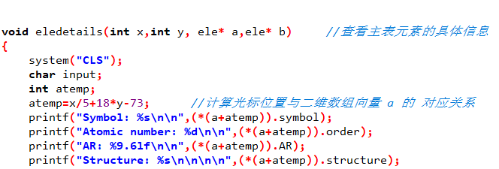

Main codes

Slide 8
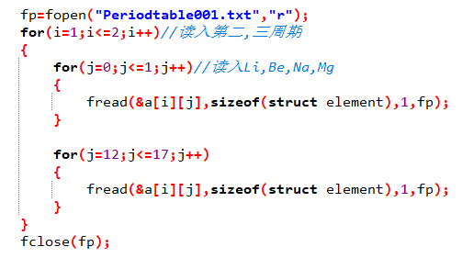

Main codes

Slide 9
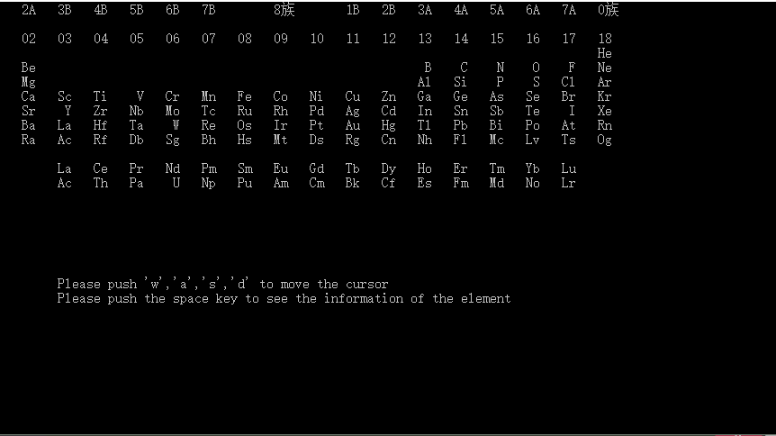
Demonstration

Slide 10
Poker Game: Draw Turtle
Part 2

Slide 11




Design Idea
Function & Highlights
Main Code
.

Slide 12
Design Idea
Poker Game
Step 1
Step 3
Step 5
Deal
First Draw
Show
First deal
cycle draw until the first winner comes out
show the tortoise and rank
Remove
Second Draw
remove the pairs in your hand
two players circle draw card until the second winner comes out
Step 2
Step 4

Slide 13






Functions & Highlights
6 functions
Change Function
Deal Function
Exchange the player's own hand cards position
Generate 52 cards and distribute them randomly
Judgement Function
Functions
Remove Function
Judge the victory and calculate the score
Find and remove the pairs of poker in your hand
Shuffle Function
Draw Function
Mess up computers’ card group
Achieve random drawing and circulation drawing

Slide 14




Functions & Highlights
4 highlights
Judgement
Use the switch statement to determine the winner
Build
Generate numbers and colors with random numbers and divisions
Draw
Use random numbers and pointers to implement values between two arrays
Remove
Convert the values of the cards into 0, rearrange and output all cards that are not 0

Slide 15
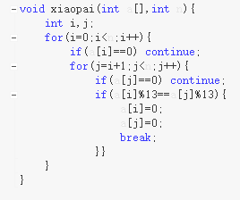
Main codes

Slide 16
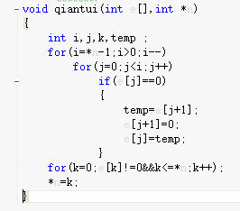
Main codes

Slide 17
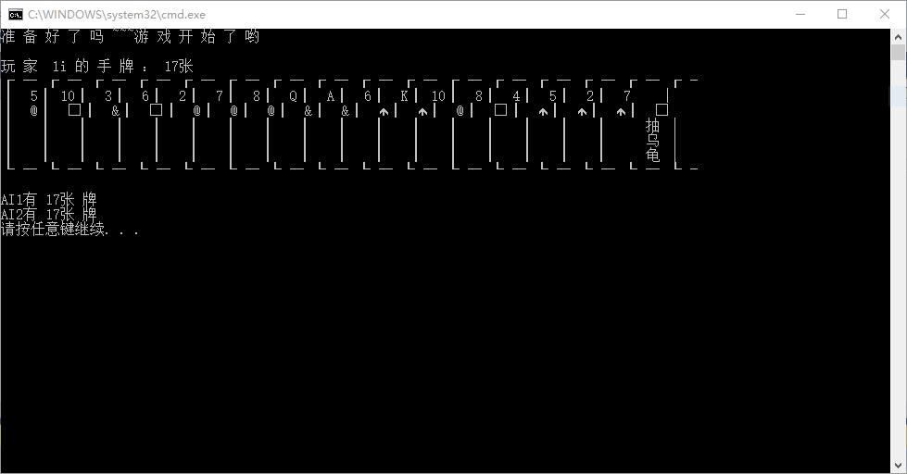
Demonstration

Slide 18
Team Members Introduction
3 columns
Leader Li Qiyuan
Main function in poker game and landscape the program
Member 1 Li Changlin
Compile the periodic table of chemical elements
Drawing the picture, writing the game rules of the poker game
Member 2 Han Ningxu
Most of the functional functions ,like card, deal, remove, shuffle and judgement functions in poker game

Slide 19
Thank You for Watching!
Any Questions?

